Slide 1

Analysis of Algorithms

Slide 2
Subject Code: CO201 Course Title: Data Structures
Text Books:
Horowitz and Sahni, “Fundamentals of Data structures”, Galgotia publications,1983
2. Tannenbaum, “Data Structures”, PHI, 2007( Fifth Impression)
3. An introduction to data structures and application by Jean Paul Tremblay & Pal G. Sorenson (McGraw Hill).
Reference Books:
R.L. Kruse, B.P. Leary, C.L. Tondo, “Data structure and program design in C”, PHI, 2009( Fourth Impression)

Slide 3
Course Objective (CO):
To study different kinds of data structures with their respective applications.
Prerequisites for this course
Fundamentals of Programming

Slide 4
Analysis of Algorithms
An algorithm is a finite set of precise instructions for performing a computation or for solving a problem.
What is the goal of analysis of algorithms?
  To compare algorithms mainly in terms of running time but also in terms of other factors (e.g., memory requirements, programmer's effort etc.)
What do we mean by running time analysis?
  Determine how running time increases as the size of the problem increases.

Slide 5
Time Complexity
Every problem has a size as an integer value, which is measured by the quantity of input data. For example size of a graph can be number of edges and size of sort can be number of elements in the list to be sorted.
Time required for an algorithm is called the time complexity of the algorithm and is represented as a function of the size of a problem.

Slide 6
Time space tradeoff
It is really quite important, even now, to have efficiency in both space and time.
Of course, the type of compromise made depends on the situation, but generally, for most programmers, time is of the essence, while for locations in which memory is scarce, of course, space is the issue.
Maybe someday we'll be able to find algorithms that are extremely efficient in both speed and memory, bridges in the Space-Time continuum.

Slide 7
Input Size
Time and space complexity
  This is generally a function of the input size
    E.g., sorting, multiplication
  How we characterize input size depends:
    Sorting: number of input items
    Multiplication: total number of bits
    Graph algorithms: number of nodes & edges
    Etc

Slide 8
Empirical Study
Write a program implementing the algorithm
Run program with inputs of varying size and composition
Use a function, like the built-in clock(), System.currentTimeMillis() function, to get an accurate measure of the actual running time in NSec/Size
Plot the results and find the complexity pattern
Good for embedded/small devices or where the product is to be manufactured in millions of units

Slide 9
Difficulties in empirical study
Necessary to implement the algorithm, which may be difficult
Results may not be indicative of the running time on other inputs not included in the experiment.
Same HardWare and SoftWare environments must be used to compare
Even in same environments results vary based on processor load, sharing of resources, no of background processes, status of primary and secondary memory at time of running program, compiler, network architecture, programming language and processor architecture

Slide 10
Micro Analysis
To count each and every operation of the program.
It is detailed, takes more time, complex
Average lines of codes are 3 to 5 million lines
Those operations which are not dependent upon the size or number of the input will take constant time and will not participate in the growth of the time or space function, So they need not be part of our analysis

Slide 11
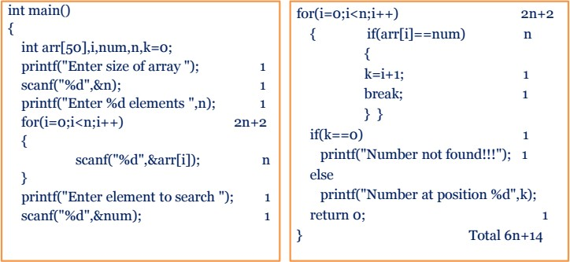
Linear Search Example

Slide 12
Macro Analysis
Deals with selective instructions which are dominant and costliest. Selection of right instructions is very important
Comparisons and Swapping are basic operations in sorting algorithms
Arithmetic operations are basic operations in math algorithms
Comparisons are basic operations in searching algorithms
Multiplication and Addition are basic operations in matrix multiplication algorithms

Slide 13
How do we compare algorithms?
We need to define a number of objective measures.
  Compare execution times?
Not good: times are specific to a particular computer !!
  Count the number of statements executed?
Not good: number of statements vary with the programming language as well as the style of the individual programmer.

Slide 14
Ideal Solution
Express running time as a function of the input size n (i.e., f(n)).
Compare different functions corresponding to running times.
Such an analysis is independent of machine time, programming style, etc.

Slide 15
Types of Analysis
Worst case
  Provides an upper bound on running time
  An absolute guarantee that the algorithm would not run longer,
no matter what the inputs are
Best case
  Provides a lower bound on running time
  Input is the one for which the algorithm runs the fastest
Lower Bound ≤ Running Time ≤Upper Bound
Average case
  Provides a prediction about the running time
  Assumes that the input is random

Slide 16
Asymptotic Analysis
Asymptotic analysis means studying the behavior of the function when n approaches to infinity or very large
Problems size will keep on increasing so asymptotic analysis is very important. It has limiting behavior. We are concerned with large input size.
To compare two algorithms with running times f(n) and g(n), we need a rough measure that characterizes how fast each function grows.
Hint: use rate of growth
Compare functions in the limit, that is, asymptotically!
(i.e., for large values of n)

Slide 17
Rate of Growth
Consider the example of buying elephants and
goldfish:
Cost: cost_of_elephants + cost_of_goldfish
Cost ~ cost_of_elephants (approximation)
The low order terms in a function are relatively insignificant for large n
n⁴ + 100n² + 10n + 50 ~
_{n}4
i.e., we say that n⁴ + 100n² + 10n + 50 and n⁴
have the same rate of growth

Slide 18
Asymptotic Notation
O notation: asymptotic “less than”:
– f(n)=O(g(n)) implies: f(n) “≤” g(n)
Ω notation: asymptotic “greater than”:
– f(n)= Ω (g(n)) implies: f(n) “≥” g(n)
Θ notation: asymptotic “equality”:
– f(n)= Θ (g(n)) implies: f(n) “=” g(n)

Slide 19
Asymptotic growth rate
O(g(n)): class of functions f(n) that grow no faster
than g(n)
Θ (g(n)): class of functions f(n) that grow at same rate as g(n)
Ω(g(n)): class of functions f(n) that grow at least as fast as g(n)

Slide 20
Big-O Notation
We say f_{A}(n)=30n+8 is order n, or O (n) It is, at most, roughly proportional to n.
f_{B}(n)=n²+1 is order n², or O(n²). It is, at most, roughly proportional to n².
In general, any O(n²) function is faster- growing than any O(n) function.

Slide 21
Visualizing Orders of Growth
On a graph, as you go to the
right, a faster growing function eventually becomes larger...
Value of function →
f_{A}(n)=30n+8
f_{B}(n)=n²+1
Increasing n →

Slide 22
More Examples …
n⁴ + 100n² + 10n + 50 is O(n⁴)
10n³ + 2n² is O(n³)
n³ - n² is O(n³)
constants
– 10 is O(1)
– 1273 is O(1)

Slide 23
Example
Algorithm 1
Algorithm 2
Cost
arr[0] = 0; c₁
arr[1] = 0; c₁
arr[2] = 0; c₁
...
arr[N-1] = 0; c₁
Cost c₂ c₁
for(i=0; i<N; i++) arr[i] = 0;
c₁+c₁+...+c₁ = c₁ x N
(N+1) x c₂ + N x c₁ =
(c₂ + c₁) x N + c₂
Both algorithms are of the same order: O(N)

Slide 24
Example (cont’d)
Algorithm 3
sum = 0;
for(i=0; i<N; i++) for(j=0; j<N; j++) sum += arr[i][j];
Cost c₁ c₂ c₂ c₃
c₁ + c₂ x (N+1) + c₂ x N x (N+1) + c₃ x N² = O(N²)

Slide 25
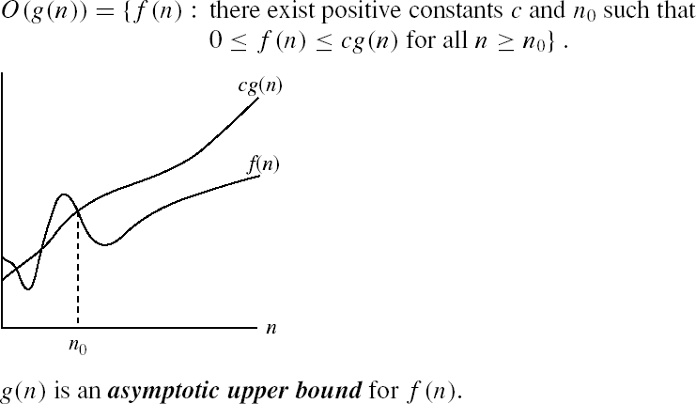
Asymptotic notations
O-notation

Slide 26
No Uniqueness
There is no unique set of values for n₀ and c in proving the asymptotic bounds
Prove that 100n + 5 = O(n²)
– 100n + 5 ≤ 100n + n = 101n ≤ 101n²
for all n ≥ 5
n₀ = 5 and c = 101 is a solution
– 100n + 5 ≤ 100n + 5n = 105n ≤ 105n²
for all n ≥ 1
n₀ = 1 and c = 105 is also a solution
Must find SOME constants c and n₀ that satisfy the asymptotic notation relation

Slide 27
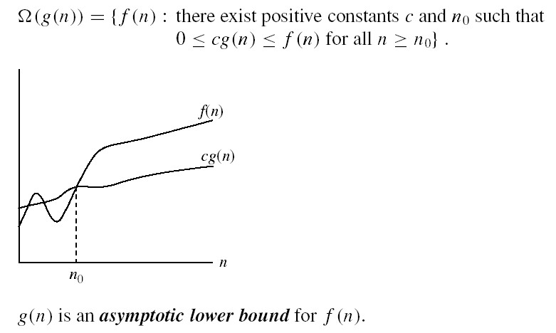
Asymptotic notations (cont.)
Ω - notation
Ω(g(n)) is the set of functions with larger or same order of growth as g(n)

Slide 28
Examples
– 5n² = Ω(n)
∃ c, n₀ such that: 0 ≤ cn ≤ 5n² ⇒ cn ≤ 5n² ⇒ c = 1 and n₀ = 1
– 100n + 5 ≠ Ω(n²)
∃ c, n₀ such that: 0 ≤ cn² ≤ 100n + 5 100n + 5 ≤ 100n + 5n (∀ n ≥ 1) = 105n
cn² ≤ 105n ⇒ n(cn – 105) ≤ 0
Since n is positive ⇒ cn – 105 ≤ 0 ⇒ n ≤ 105/c
⇒ contradiction: n cannot be smaller than a constant

Slide 29

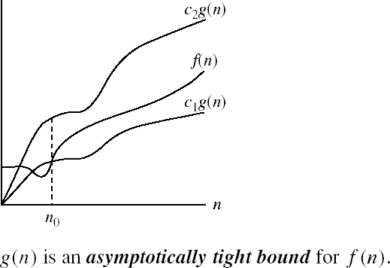
Asymptotic notations (cont.)
Θ-notation
Θ(g(n)) is the set of functions with the same order of growth as g(n)

Slide 30
Examples
– n²/2 –n/2 = Θ(n²)
⇒ c₂= ½ , c₁= 1/14 and n₀ = 7
– n ≠ Θ(n²): c₁ n² ≤ n ≤ c₂ n²
⇒ only holds for: n ≤ 1/c₁

Slide 31
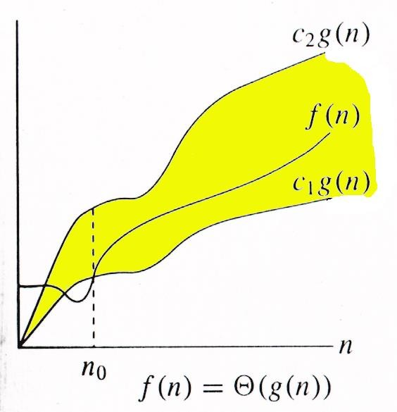
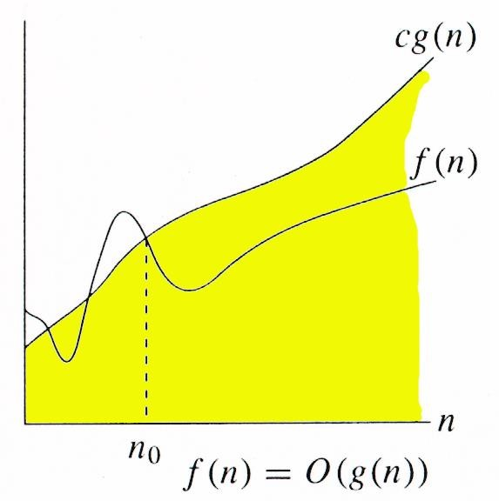
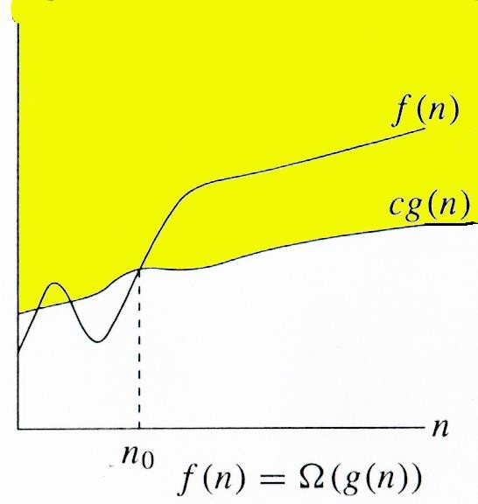
Relations Between Θ, O, Ω

Slide 32
Common Complexity terms
S.NO | Big O Notation | Name
1. | O(1) | Constant Space Complexity
2. | O(log n) | Logarithmic Space Complexity
3. | O(n) | Linear Space complexity
4. | O(n log n) | Linearithmic Space Complexity
5. | O(n^2) | Quadratic Space Complexity
6. | O(n^3) | Cubic Space Complexity
7. | O(n^y) | Polynomial Space Complexity
8. | O(2^n) | Exponential Space Complexity
9. | O(n!) | Factorial Space Complexity

Slide 33
Practice 1
What is time complexity for following?
Carry n items from one room to another room.
Locating patient record in Doctor Office
Store manager gives gifts to first 10 customers standing in the queue.

Slide 34
Practice 2
A( )
{ int a=0;
for(int i=1; i<=m; i++)
{--}
for(int j=1; j<=n; j++)
{--}
}

Slide 35
Practice 3
A( )
{ int a=0;
for(int i=1; i<=m; i++)
for(int j=1; j<=n; j++)
{--}
}

Slide 36
Practice 4
A( )
{ int a=0;
for(int i=1; i<=n; i=i*2)
{--}
}

